Slide 1
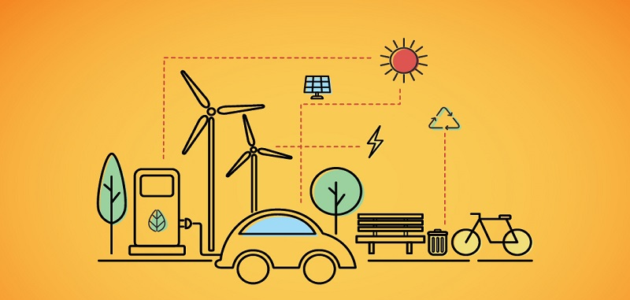
Unit 10: TRANSPORT

Slide 2
QUESTIONS
Part 1
Part 2
1. What means of transport do you usually use?
2. What’s the most popular means of transportation in your hometown?
3. How often do you take the bus?
4. Which do you prefer public transportation or private transportation?
5. What do you think about the transport system in your hometown?
…
1. Describe a journey you make every day
2. Describe the public transport system in your city
3. Describe a time when your vehicle was broken when travelling

Slide 3
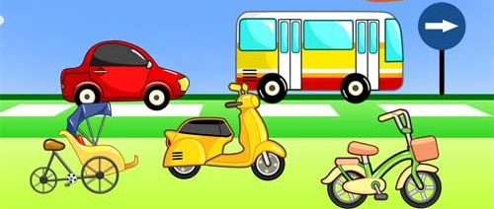
vocabulary
✴ Travel / commute by + phương tiện
Drive +
a car
take/use +
bus / coach
Ride +
a cyclo
a motorbike
a motorcycle
a scooter
an electric bike/bicyle

Slide 4
1. What means of transport do you usually use?
Example 1: Well for daily commute, I often hop on my private motorbike. Sometimes when my motorbike is broken down, I choose to hitch a ride with my friend.
Example 2: Well, living with a student budget, I can’t afford an electric bike for myself, so I cycle to school on a daily basis. I consider this the best way to exercise.
daily commute (n): sự đi lại hàng ngày
student budget (n):
hop on (v): nhảy lên xe
afford (v): đủ khả năng mua…
be broken down / break down: hỏng xe
cycle (v): đạp xe
hitch a ride: đi nhờ xe
on a daily basis (v): hàng ngày

Slide 5
2. What’s the most popular means of transportation in your hometown?
Example 1: Motorbike, absolutely. I guess every adult Vietnamese own at least one motorbike because of its reasonable price compared to automobiles. In addition, the small size of a motorbike allows drivers to travel faster and manoeuvre easily in such terrible traffic condition.
/ˈɔː.tə.mə.biːl/
/məˈnuː.vər/
Reasonable price (n): giá cả phải chăng
Automobile (n): xe hơi
Manoeuvre (v): di chuyển, điều hướng
Traffic condition (v): điều kiện giao thông

Slide 6
3. Which do you prefer public transportation or private transportation?
Example 1: Well it surely depends. If I commute to work, motorbike is absolutely the perfect choice because of its convenience. However, with longer trips, public transportation like buses, trains or planes are more crucial. I like popping in my earbuds and zoning out while sitting in a train.
pop in my earbuds (idiom): nghe nhạc
zone out (v)

Slide 7
4. What do you think about the transport system in your hometown?
Example 1: The traffic during rush hours in my hometown is always very heavy. All the streets are jampacked, there are thousands of vehicles such as motorbikes, cars and buses getting stuck in many big avenues. Besides, many commuters don’t allow traffic rules and just travel by their own instinct, which causes a lot of traffic accidents.
Rush hour (n): giờ cao điểm
Traffic rules (n): luật giao thông
Jampacked (adj): quá chật
Instinct (n): bản năng
get stuck (v): bị tắc
avenues (n): đại lộ

